Slide 1
SCHOOLS OF PSYCHOLOGY
Dr J Balamurugan

Slide 2
Schools of Psychology
‘Psychology has a long past, but its real history is short’ -Ebbinghaus (1908)
In the history of Psychology, strong differences of opinion about what Psychology should study and it should do it were represented by school of Psychology.
Psychologists’ differing perspectives can lead them to sharply differing views in schools of Psychology.

Slide 3
Schools of Psychology
In the first decades of the 20th century, fundamental questions were raised among Psychologists about what should be studied in Psychology: should study of mind, behaviour or mind and behaviour be included?
Different influential, Psychologists of the time held quite different views on the nature of mind and the proper subject matter for Psychology.
Schools of thought formed around these leaders and their students adopted their ideas.
Theses scholar’s thought are known as the schools of Psychology.

Slide 4
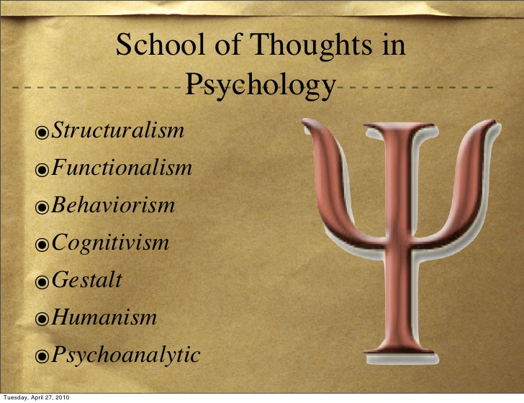

Slide 5
The Early Schools of Psychology
Psychology quickly diversified from the late 19th century, leading to a number of distinct schools:
  Structuralism, which investigated the structure of the mind
  Functionalism, which investigated the adaptive functions of the mind and behaviour
  Gestalt Psychology, which emphasized holistic aspects of patterns of mind and behaviour
  Behaviourism, which emphasized the role of the learned association and environment in guiding behaviour
  Humanism, which emphasized the prominent roles of inner dynamic forces of the qualities of individual.
  Psychoanalytic, which emphasized the role of unconscious mind in shaping behaviour

Slide 6
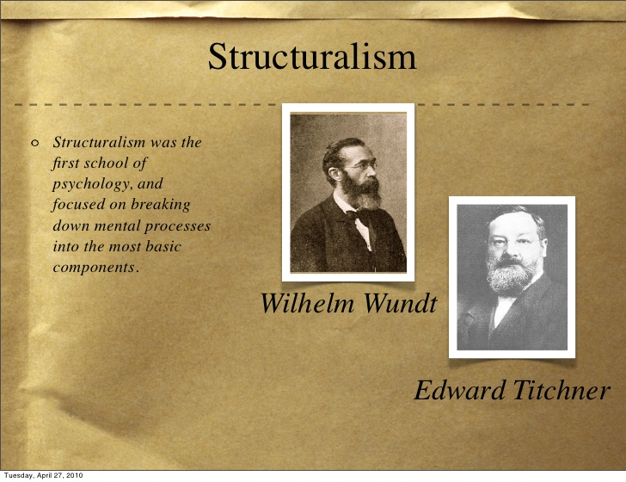

Slide 7
Structuralism can be defined as psychology as the study of the structure of conscious experience.
The structuralists used techniques such as introspection to analyze the inner processes of the human mind.
In 1879 Wilhelm Wundt began the first psychological laboratory in Leipzig, Germany

Slide 8
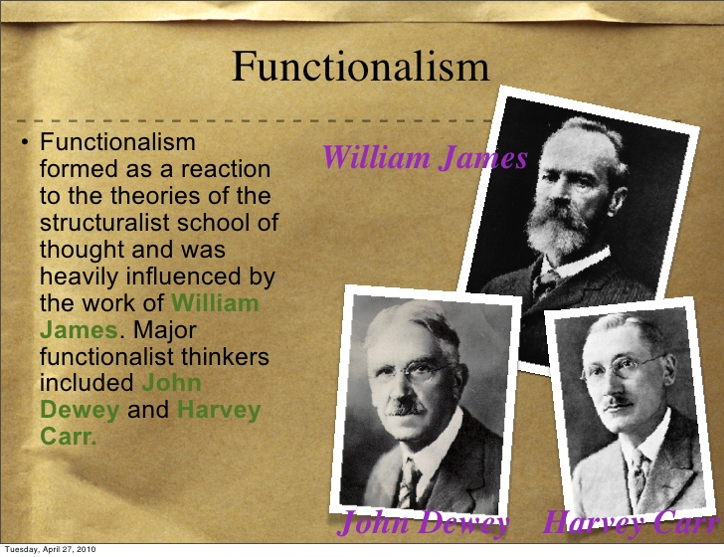

Slide 9
Functionalist concerned with how mental process help the organisms (behaviour) adapt to their environment.
Eg: If you ask something repeatedly and refused each time, probably you will stop asking the person.
It included behavioral observation in the laboratory as well as introspection.

Slide 10
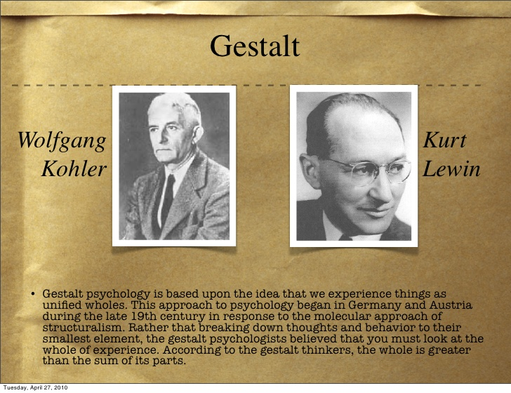

Slide 11
Gestalt psychology is a school of thought that looks at the human mind and behavior as a whole.
Individuals have tendency to perceive as whole instead of perceiving it as a part by part.
Learning is active and purposeful.
Learning is accompanied by the insight not by mechanical repetition.

Slide 12
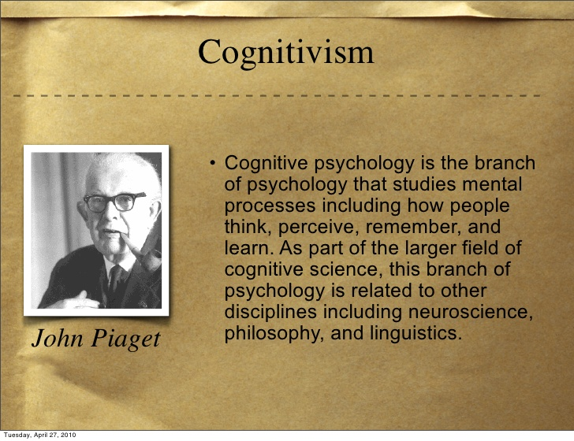

Slide 13
Theoretical Approaches
Since the 1950s, psychologists have adopted a number of diverse approaches to understanding human mind and behaviour
These different approaches include:
  Psychoanalytic
  Behaviourism
  Humanism

Slide 14
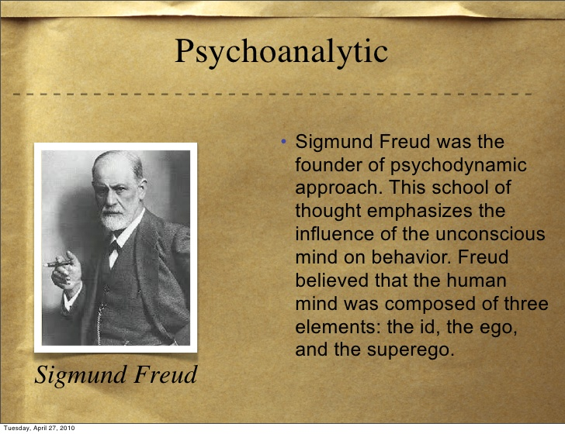

Slide 15
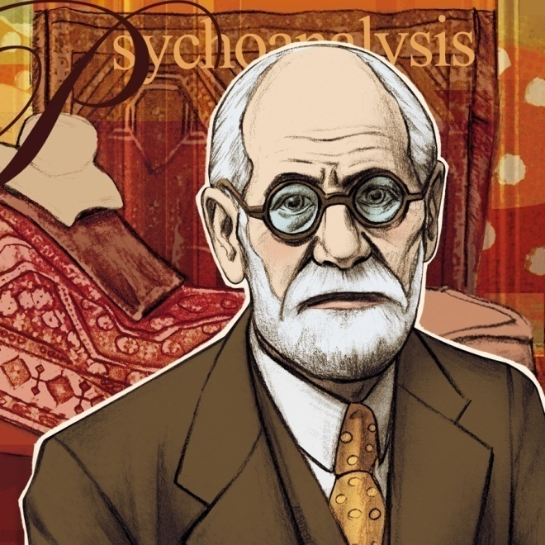
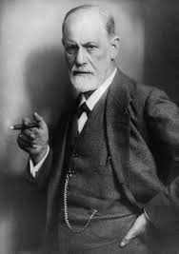
The Psychoanalytic Approach
Freud (1856-1939)
Sigmund Freud, an Austrian physician, and his followers emphasized the importance of the unconscious mind and its effects on human behavior.
Notes:
Psychology 7e in Modules

Slide 16
Psychoanalytic
Psychoanalytic is not a major school of psychology as it is not based on any kind of academic research (experimental or non-experimental) on general psychological processes such as learning, perception, memory, thinking etc.
Rather, it originated from non-academic field – medical practice.
However, its impact was revolutionary.
Sigmund Freud is founded this system during the early years of 20th century.
He developed a system for diagnosing and treating mental disorders and also attempted to explain personality in line with his system which is known as Psychoanalytic.

Slide 17
Strictly specking, Psychoanalytic is not a school of Psychology, but it has had a great impact on the thinking and theorizing of many Psychologists.
Freud developed a theory of mind and behaviour which said that much of what we do and think results from urges or drives, which seek expression in behaviour and thought.
A crucial point of these urges or drives, according to Psychoanalytic theory, is that they are hidden from the awareness of the individual; they are, in other words, unconscious.
It is expression of the unconscious drives which shows up in behaviour and thought.
The term unconscious motivation thus describes the key idea of Psychoanalysis.

Slide 18
The Psychoanalysis Approach
Key features:
Mind has 3 parts: conscious, preconscious and unconscious
  Conscious: thoughts and perceptions
  Pre-conscious: available to consciousness, e.g. memories and stored knowledge
  Unconscious: wishes and desires formed in childhood, biological urges. Determines most of behaviour
Personality has 3 components - id, ego & superego
  Id: unconscious, urges needing instant gratification
  Ego: develops in childhood, rational. Chooses between id and external demands
  Superego: conscience, places restrictions on behaviour

Slide 19
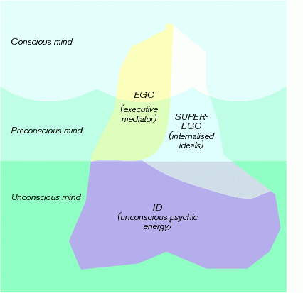
The Psychodynamic Approach
Key features:
Freud’s ‘mental iceberg’ view of the mind

Slide 20
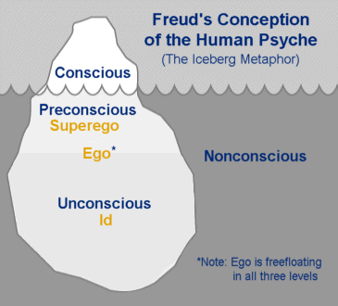
The part of your mind that makes you aware of what you’re doing and its repercussions
The ability we have as humans to evaluate ourselves and others, the ability to make judgements
The part of the mind that you have absolutely no conscious awareness of it
Your basic instincts that you do without thinking of others

Slide 21
The Psychoanalytic Approach
Significant impact:
  theories of personality, motivation, development
  therapeutic techniques in clinical and counselling psychology
  captured the popular imagination, providing an accessible framework for everyday understanding
Unscientific?
  methodologically poor
  untestable (e.g. concept of denial)
Limited impact on scientific psychology

Slide 22
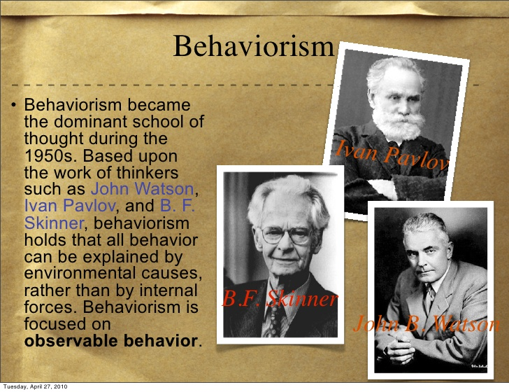

Slide 23
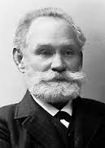
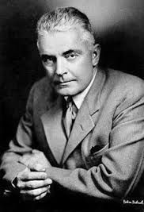
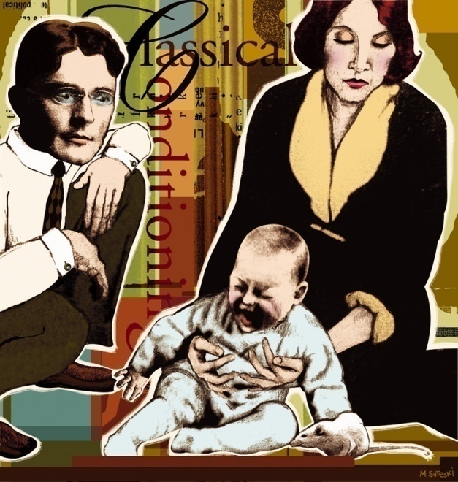
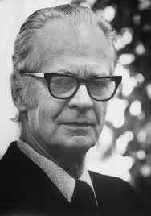
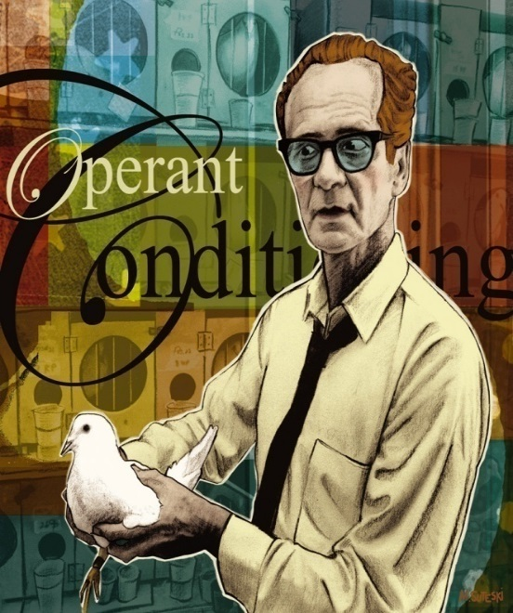
The Behaviourist Approach
Ivan Pavlov
(1849-1936)
Watson (1878-1958)
Skinner (1904-1990)
Watson and later Skinner emphasized the study of overt behavior as the subject matter of scientific psychology.
Notes:
Psychology 7e in Modules
Ivan Pavlov a Russian Physiologist, James Watson and Skinner were all instrumental in developing the science of psychology and emphasized behavior instead of mind or mental thoughts. From 1920 to 1960, psychology in the US was heavily oriented towards behaviorism.

Slide 24
Behavioursim
This school emerged as a result against structuralism.
J.B. Watson is considered as the main champion of this school of thought.
This school emphasized that the mentalistic concepts such as consciousness, images, and mind has no place in a scientific and objective science.
The method of introspection was also declared as faulty because introspective data are subjective.
Behaviourists view psychology as the science of behaviour that can be objectively observed and described.
This observation can be done in terms of stimuli and responses.

Slide 25
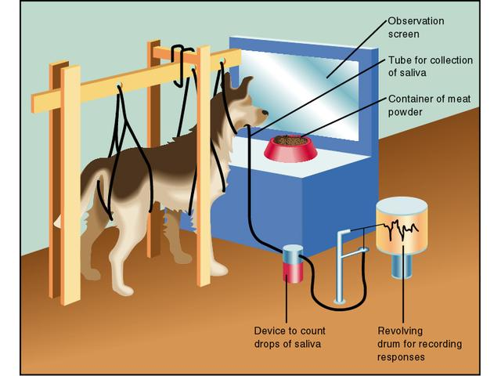
Pavlov’s Conditioning

Slide 26
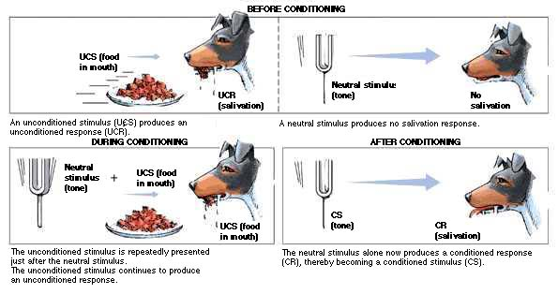

Slide 27
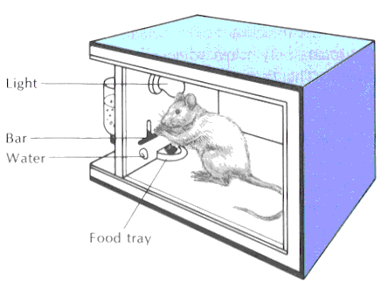
B. F. Skinner
Operant conditioning: occurs without an observable external stimulus
The behavior is instrumental in securing a stimulus more representative of everyday learning

Slide 28
The Behaviourist Approach
Behaviorism is focused on observable behavior.
Psychology as a study of behavior or response to stimuli which can be measured and studied objectively.
Key features:
Rejects the investigation of internal mental processes
Emphasises the investigation of observable behaviour
Emphasises the importance of the environment
Behaviour is the result of learned associations between stimuli and responses to them
The main theories are of classical (Pavlov) and operant conditioning

Slide 29
The Behaviourist Approach
Evaluation:
Its practical focus has led to useful applications
It has influenced theory development, e.g. in the area of learning
It developed a standard scientific methodology, through the use of hypothesis testing and experimental control
It’s criticized for being mechanistic (ignoring mental processes) and overly environmentally determinist (it ignores biology)

Slide 30
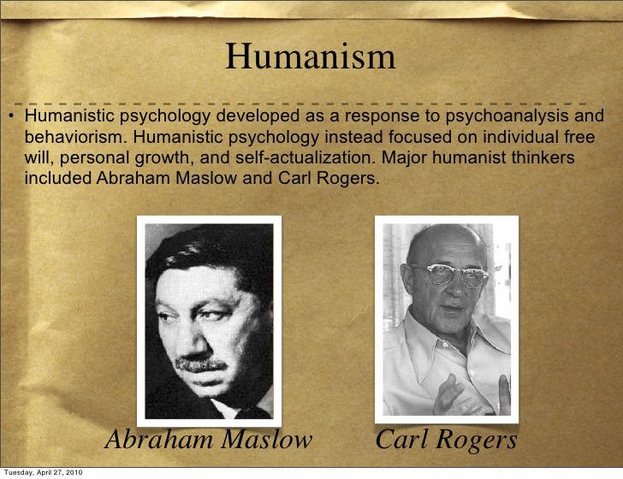

Slide 31
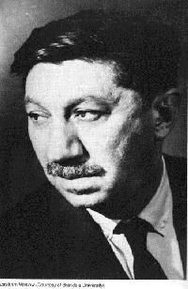
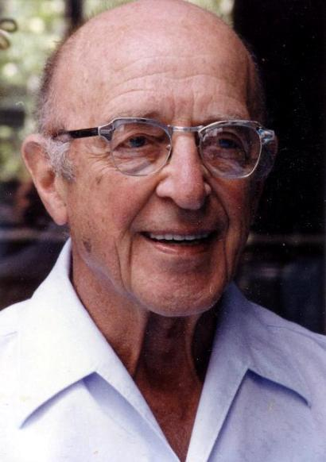
The Humanistic Approach
Maslow (1908-1970)
Rogers (1902-1987)
Maslow and Rogers emphasized current environmental influences on our growth potential and our need for love and acceptance.
Notes:
Psychology 7e in Modules

Slide 32
Humanism
It typically holds that people are inherently good.
It adopts a holistic approach to human existence and pays special attention to such phenomena as creativity, free will, and human potential.
It encourages viewing ourselves as a "whole person" and encourages self exploration rather than the study of behavior and mind.
Humanistic psychology acknowledges spiritual aspiration as an integral part of the human psyche.
It has sometimes been referred to as the "third force," in psychology, distinct from the two more traditional approaches such as Psychoanalysis and Behaviourism.

Slide 33
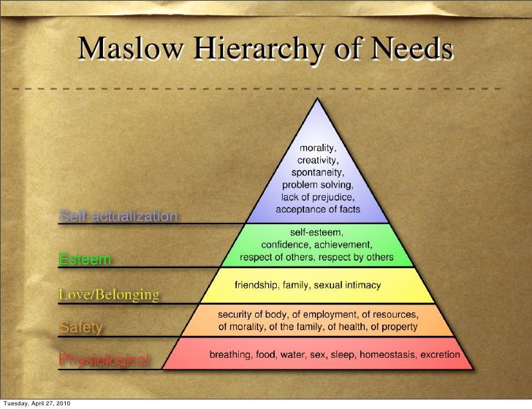

Slide 34
The Humanistic Approach
Key features
Investigates phenomena from the subjective experience of individuals.
An emphasis on holism: the need to study the whole person.
It was instead focused on each individual's potential and stressed the importance of growth and self-actualization.
The fundamental belief of humanistic psychology is that people are innately good and that mental and social problems result from deviations from this natural tendency.
Self-actualization, creativity, and individuality and related topics were the central theme of this approach.

Slide 35
The Humanistic Approach
Evaluation:
  Development of client-centred therapy
  Considerable influence on counselling
  Helped establish counselling as an independent profession
  Development of research techniques to evaluate the effectiveness of treatment
  It has limited impact on mainstream psychology
  It has limited evidence for theories

Slide 36
THANK YOU

